Slide 1
Smart Academic Communication Platform
Academic Module

Slide 2

Agenda
In this meeting, we’ll discuss about academic module of our FYP. In this presentation, I’ll show you why this module is important and how it’s used for making communication effective and personalized.

Slide 3
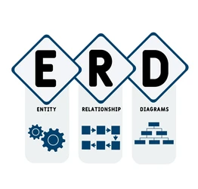
ERD Section
In this section, we’ll discuss about ERDs of the academic module. We only discuss necessary entities and their relationships specific to our application’s business requirements. We’ll avoid moving towards ERP or LMS.

Slide 4
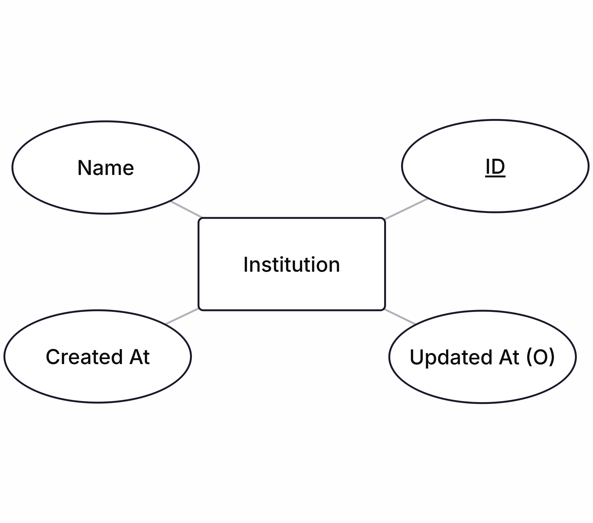
1. Institution
The Institution entity is required to manage an academic institution’s accounts (admin, faculty, student) and departments. It’ll also help adding multi-tenancy support in the future if required. It has relationships with following entities:
Admin
Faculty
Student
Department

Slide 5
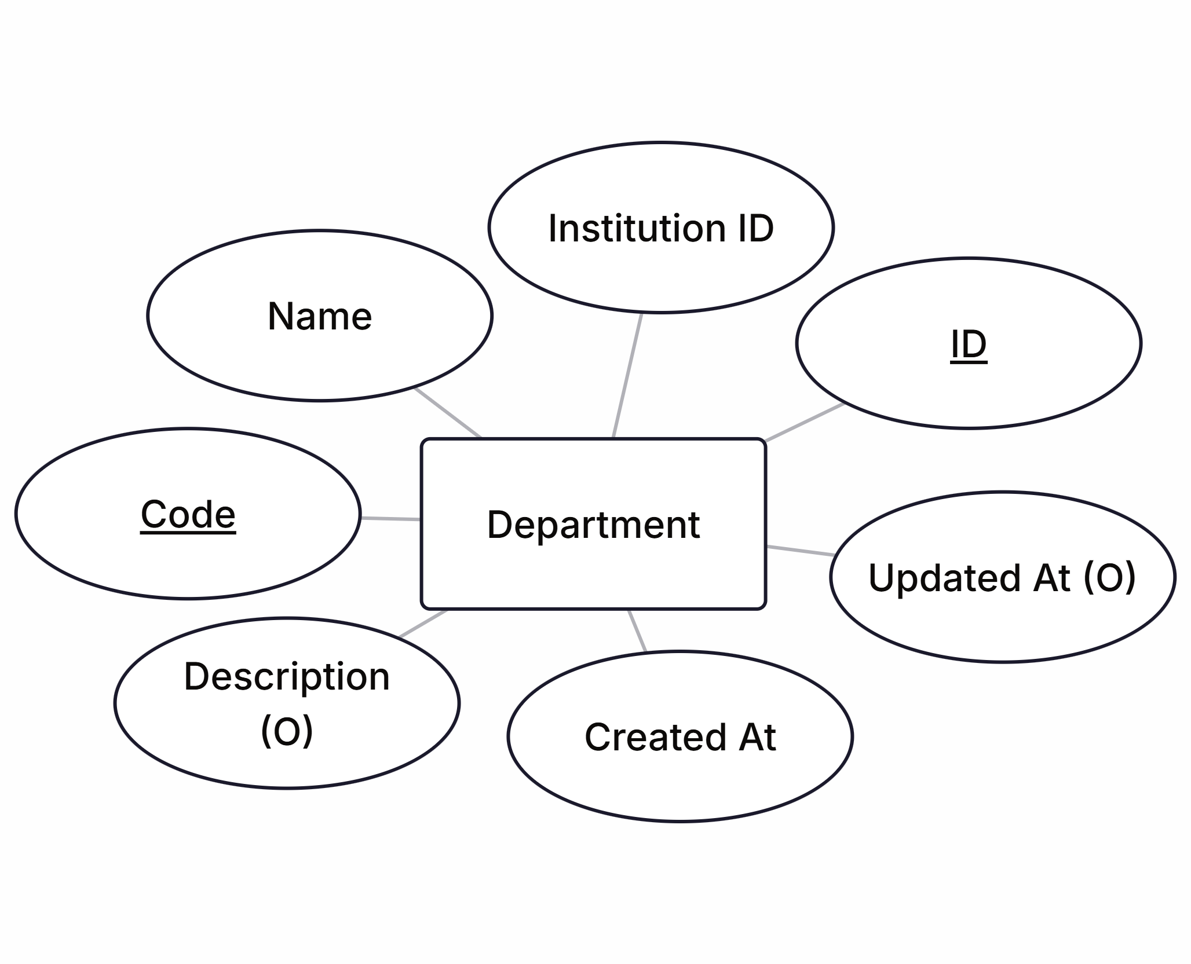
2. Department
The Department is used to manage different departments of an academic institution. It’ll help use manage both department specific communication and between other departments. It has relationships with following entities:
Institution
Student
Faculty Member
Course

Slide 6
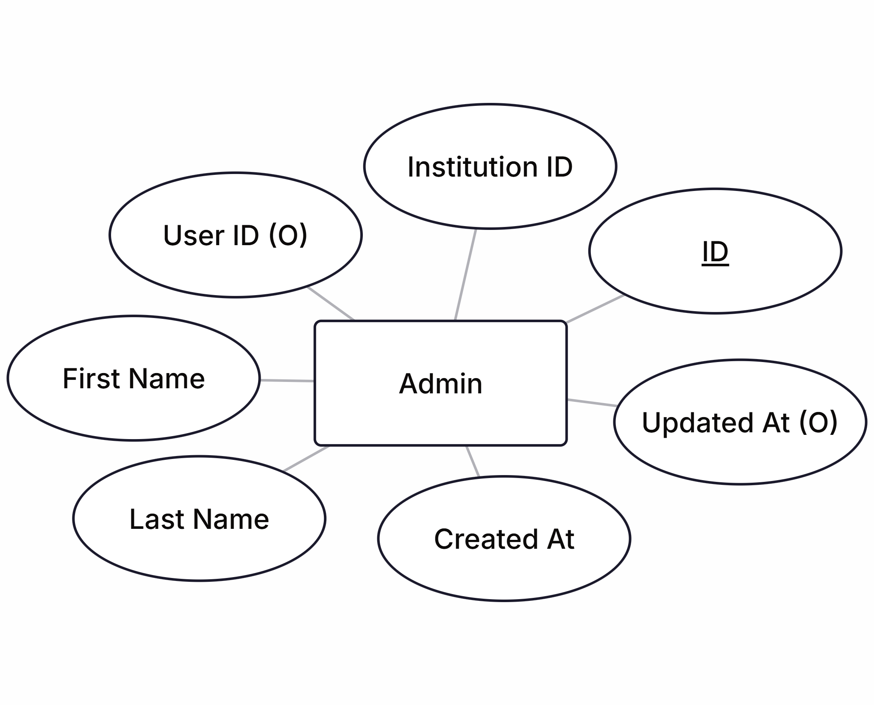

3. Admin
The Admin entity is very important for the academic institution to manage and monitor communication workflows among faculty members and students through departments. Based on current scope of SACP, there exists only one admin for a single institution. It has relationships with following entities:
User
Institution

Slide 7
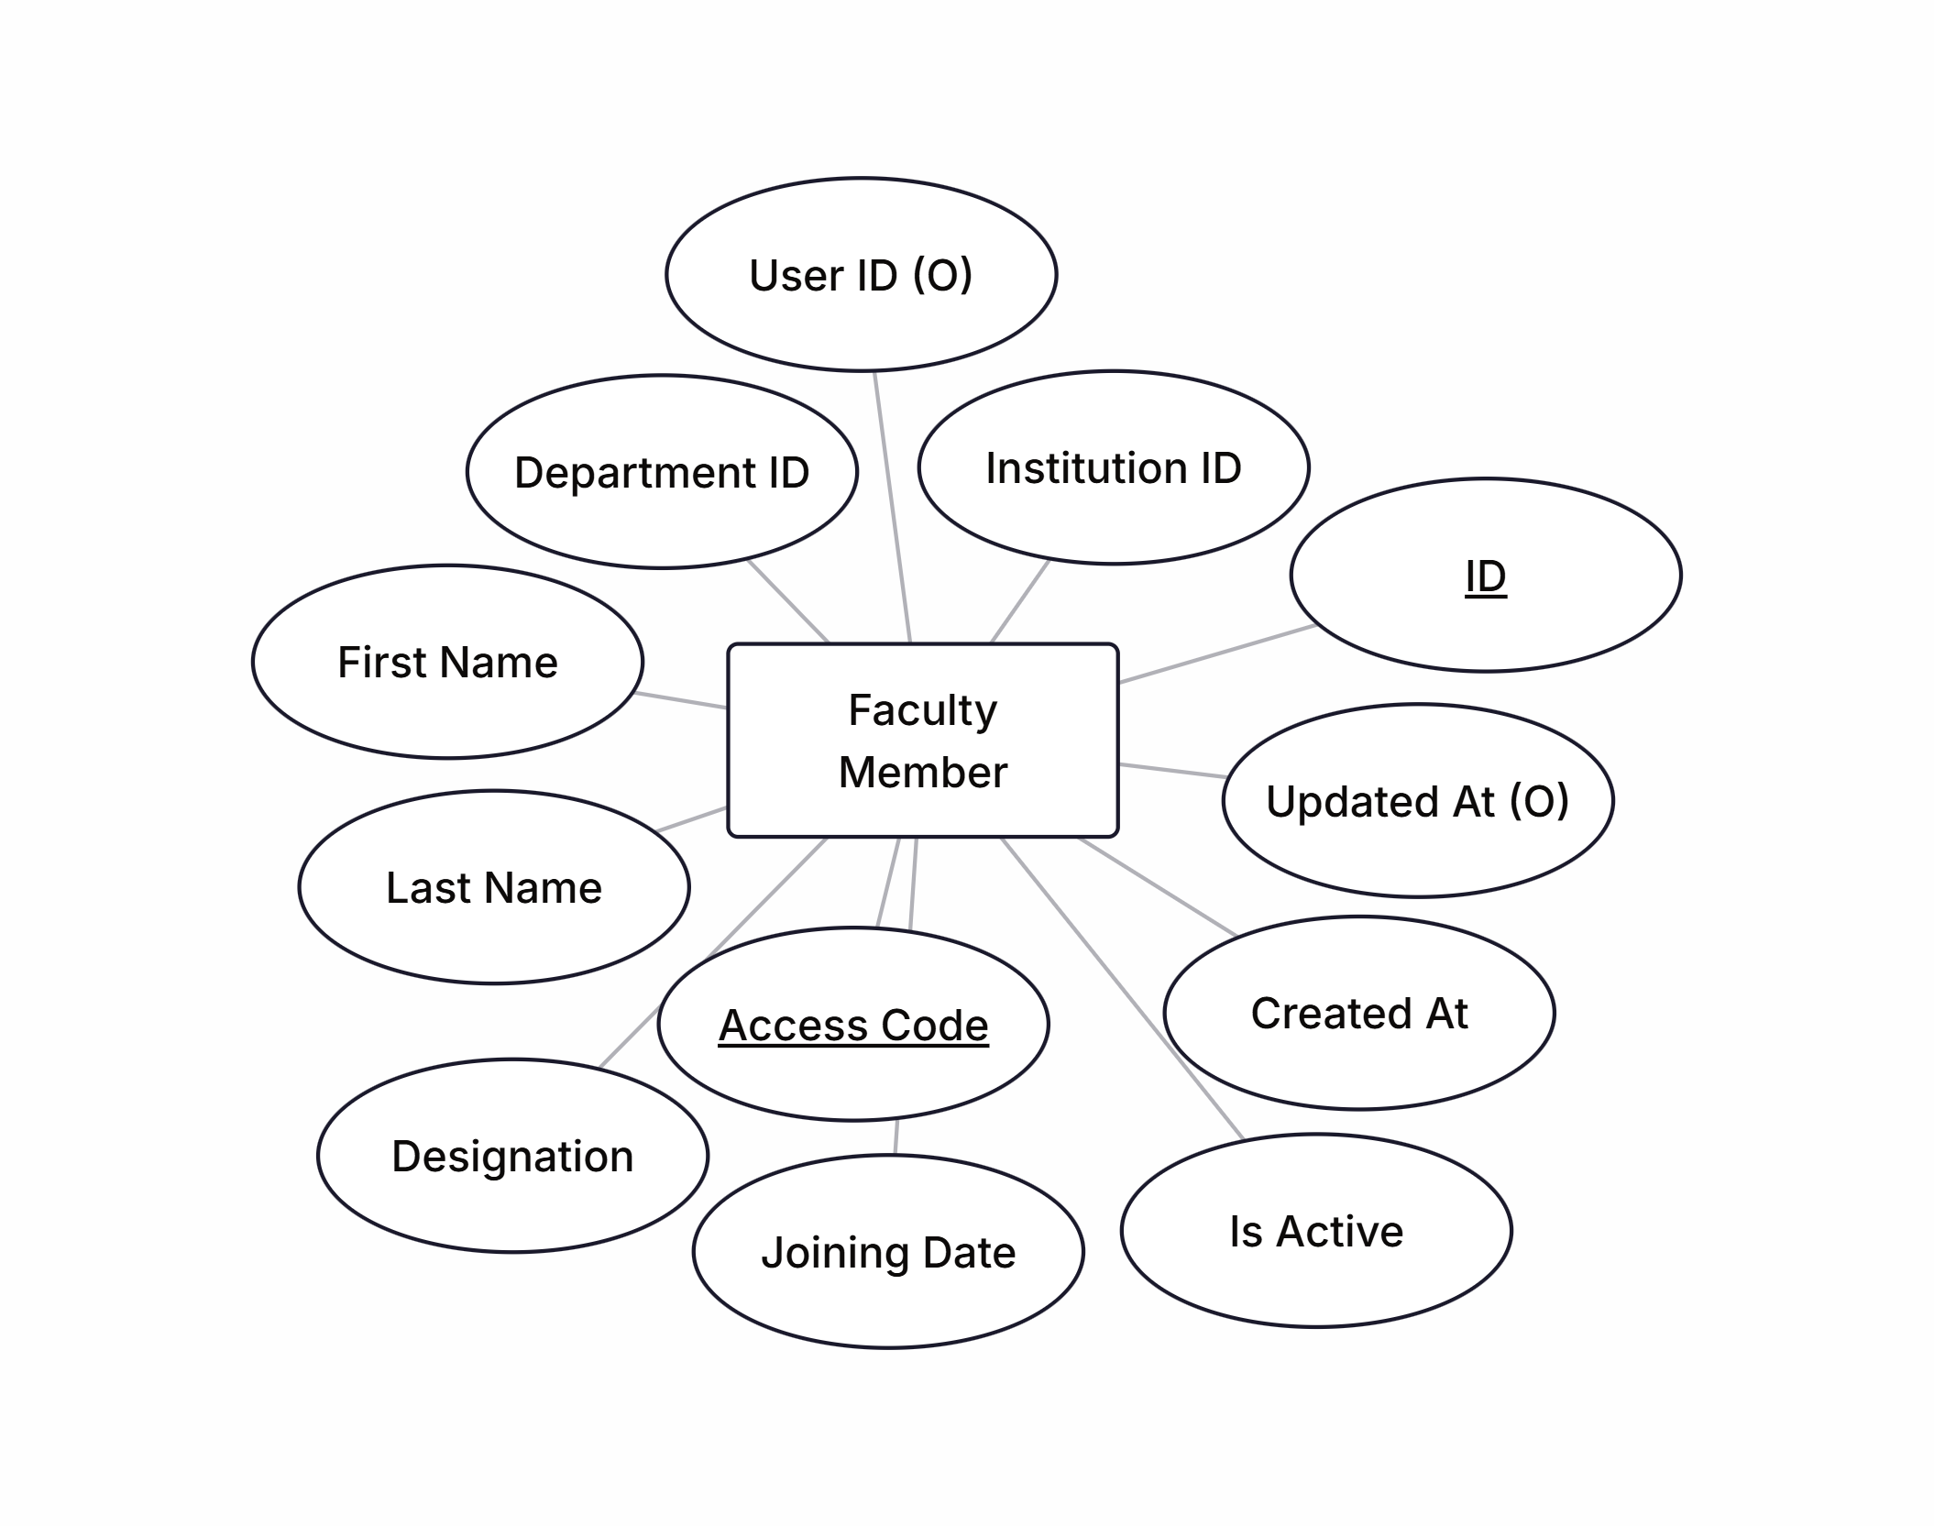
4. Faculty Member
The Faculty Member is important to manage and handle department related communication among students. It can be head of department (single for one department), lecturers, professors, etc. It has relationships with following entities:
User
Institution
Department
Course
For security concerns, this entity has automatically generated unique access code which can be used by the faculty member to get registered into SACP.

Slide 8
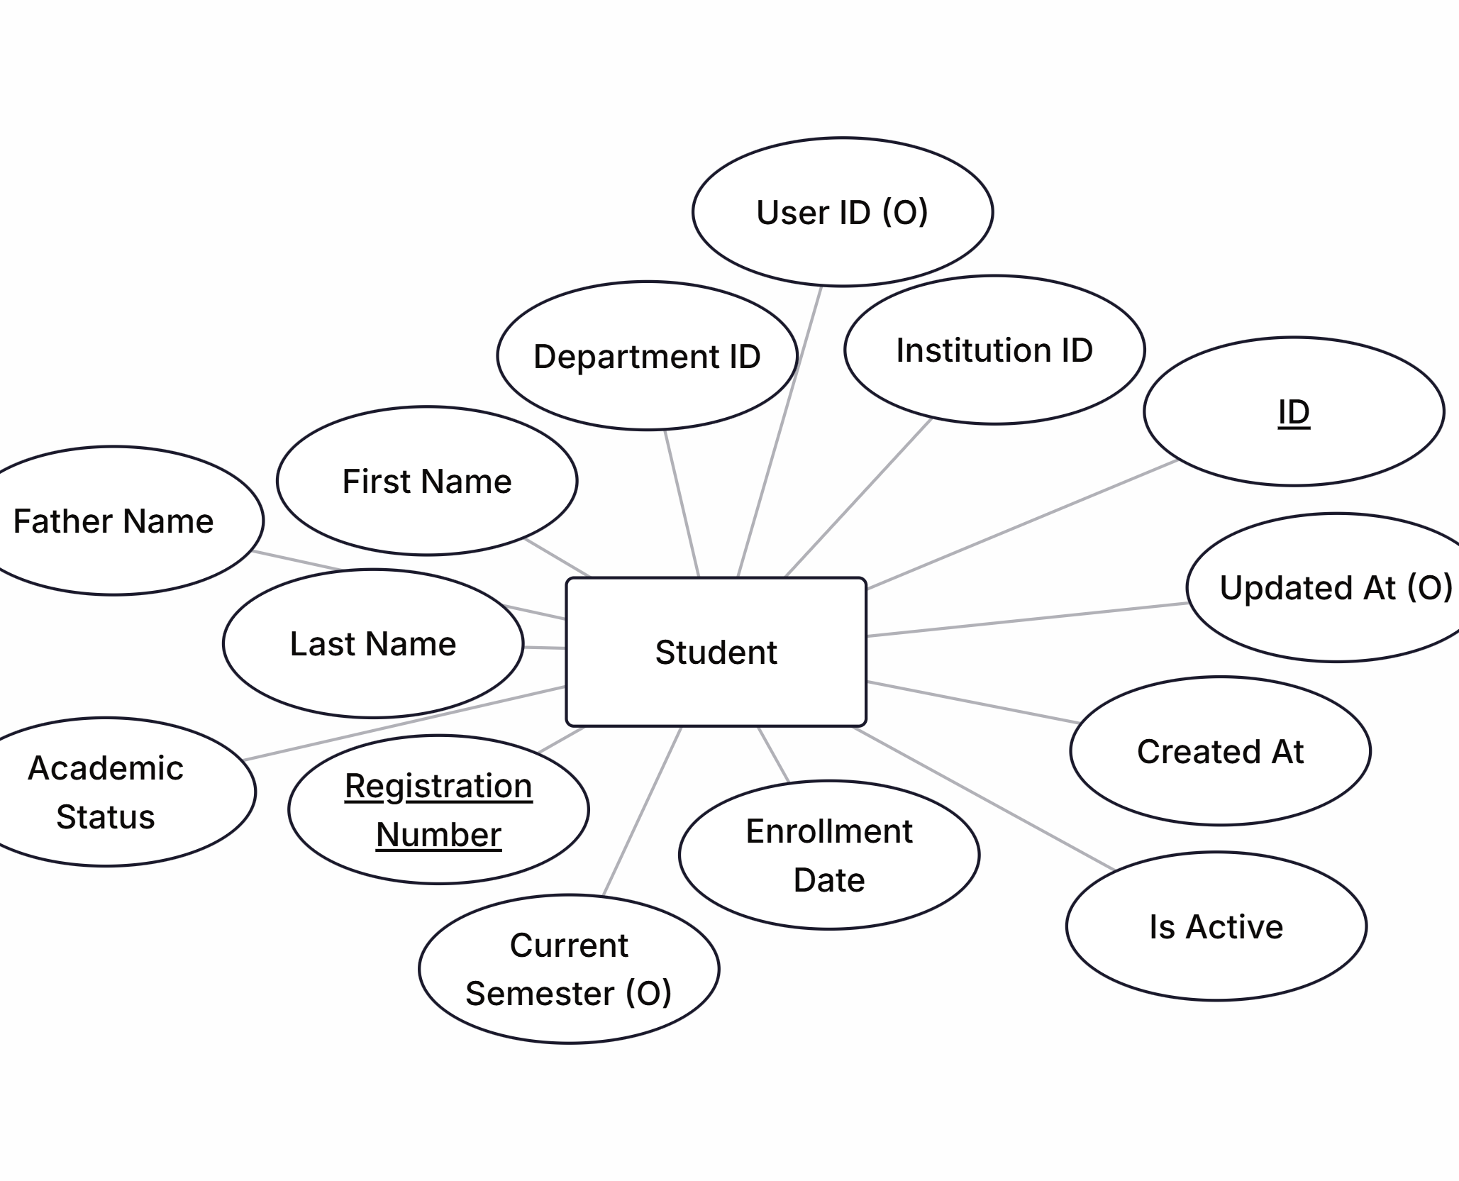
5. Student
The Student is important part of both department and course. The target audience of many academic related announcements, events, etc. will be students. It has relationship with following entities:
User
Institution
Department
Course
Exam
Student also has either automatically generated registration number or admin provider unique registration number which he/she can use to get registered in SACP.

Slide 9
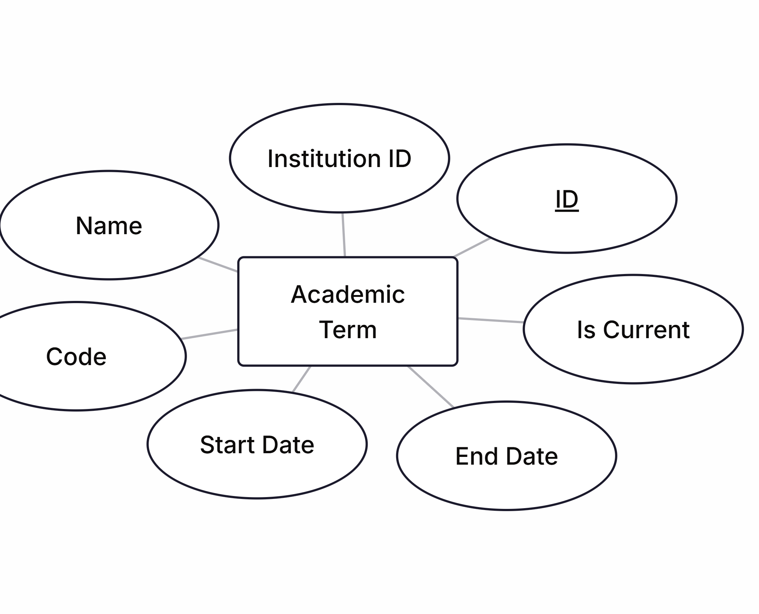
6. Academic Term
The Academic Term is basically used for adding periods like Spring 2024, Fall 2026, etc. Although, it’s not necessary regarding core business logic but a good touch for user experience in targeted and personalized communication. It has relationships with following entities:
Institution
Course
Exam

Slide 10
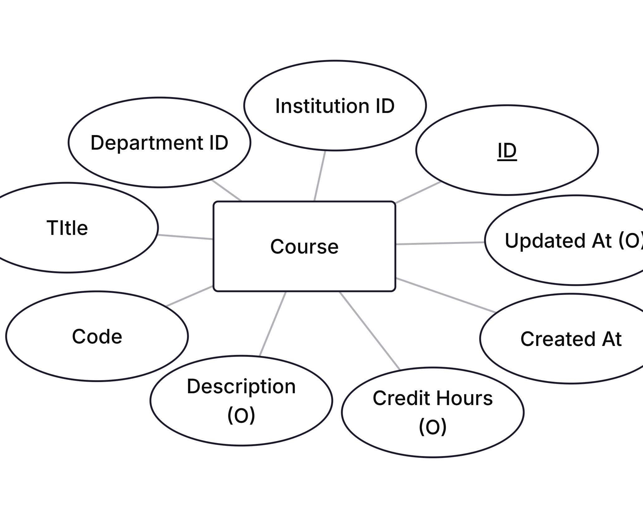
7. Course
The Course is a major thing offered by departments. Although, we don’t need to go deeper in terms of course avoiding LMS. But it’s necessary to target audience more accurately for specific announcements like exams, attendance, etc. It has relationships with following entities:
Institution
Department

Slide 11
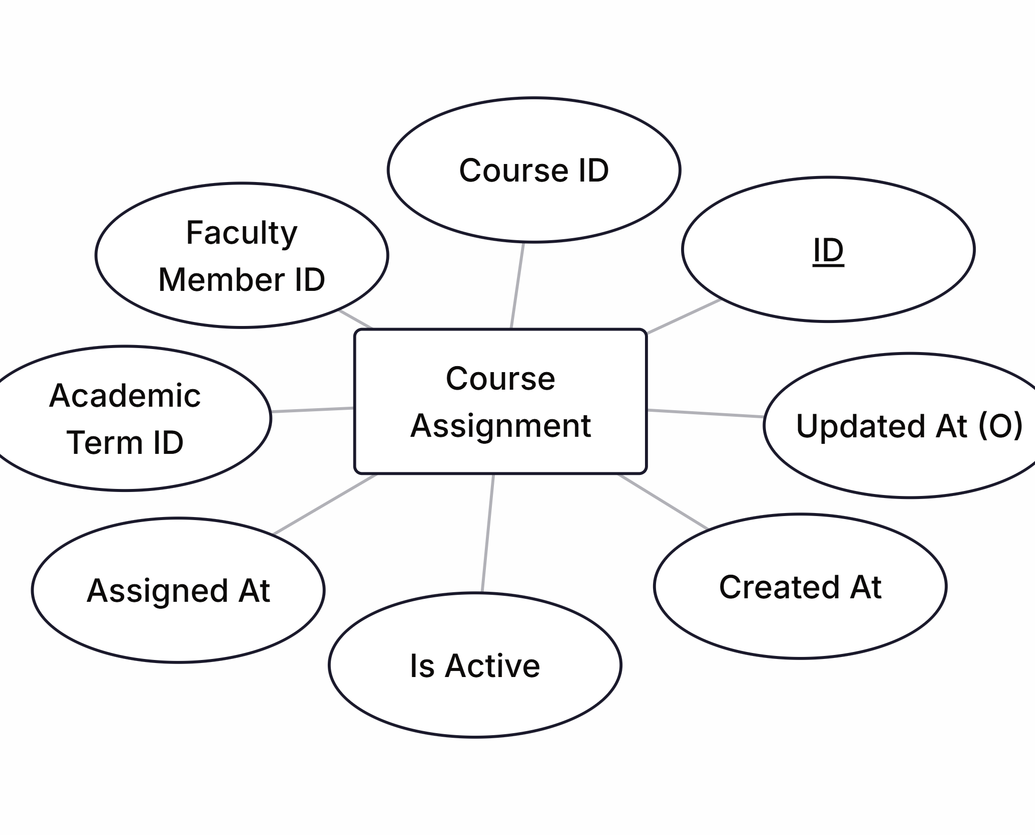
8. Course Assignment
The Course Assignment is directly related to course entity which is used to check to which faculty member, a particular course is assigned to teach to students. Unlike LMS, it’s only used to get context of course rather than managing different courses with progress, notes, lectures, etc. It has relationship with following entities:
Course
Faculty Member
Academic Term

Slide 12
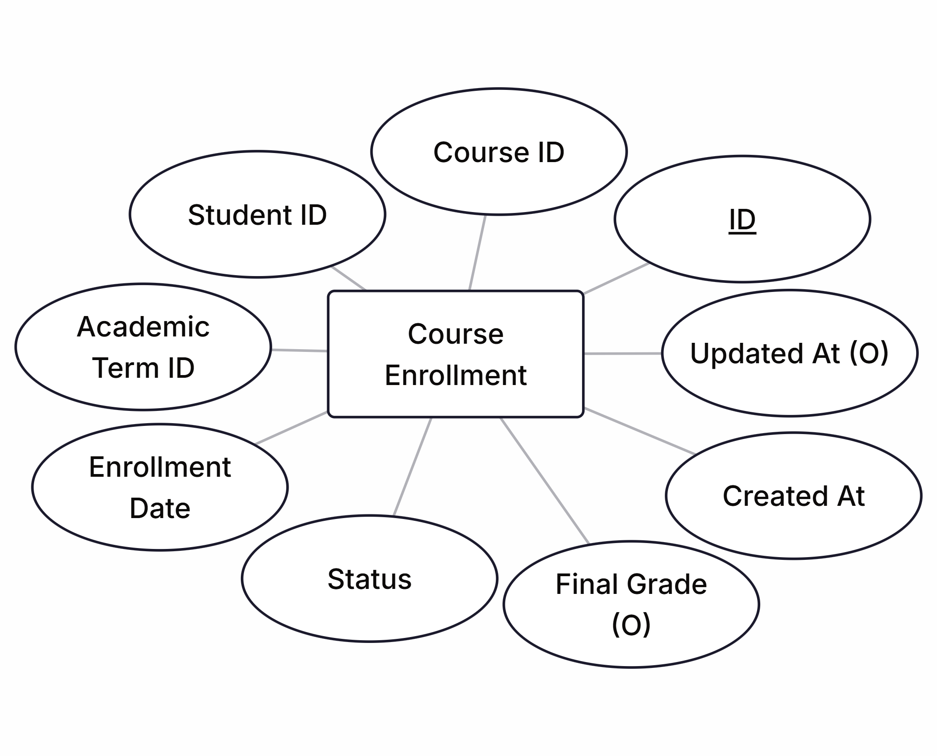
9. Course Enrollment
The Course Enrollment is basically used to get course context of all students enrolled in a particular courses in specific periods. It has relationships with following entities:
Student
Course
Academic Term

Slide 13
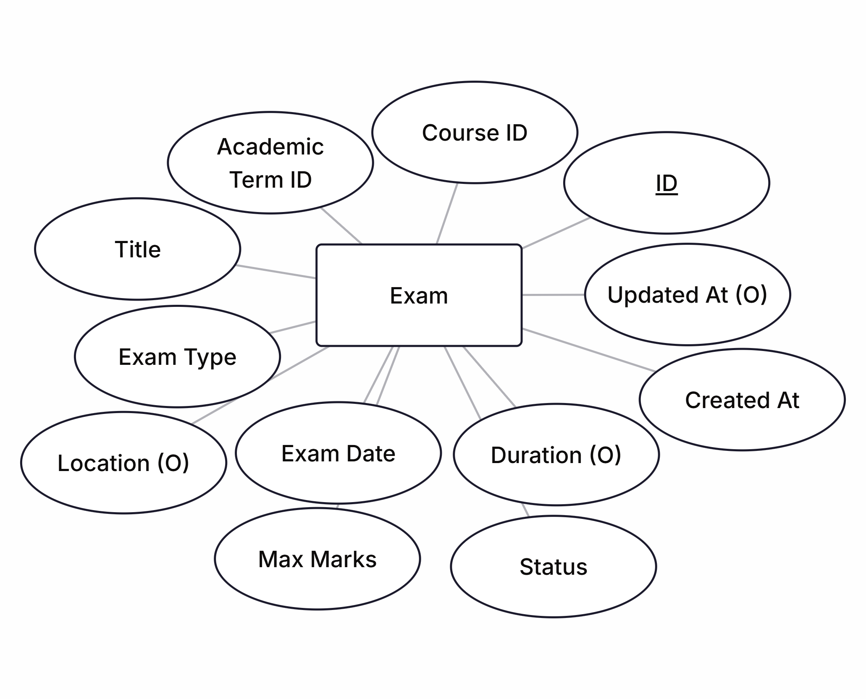
10. Exam
The Exam is used to add support for different kind of exam alerts. It has relationships with following entities:
Course
Academic Term

Slide 14
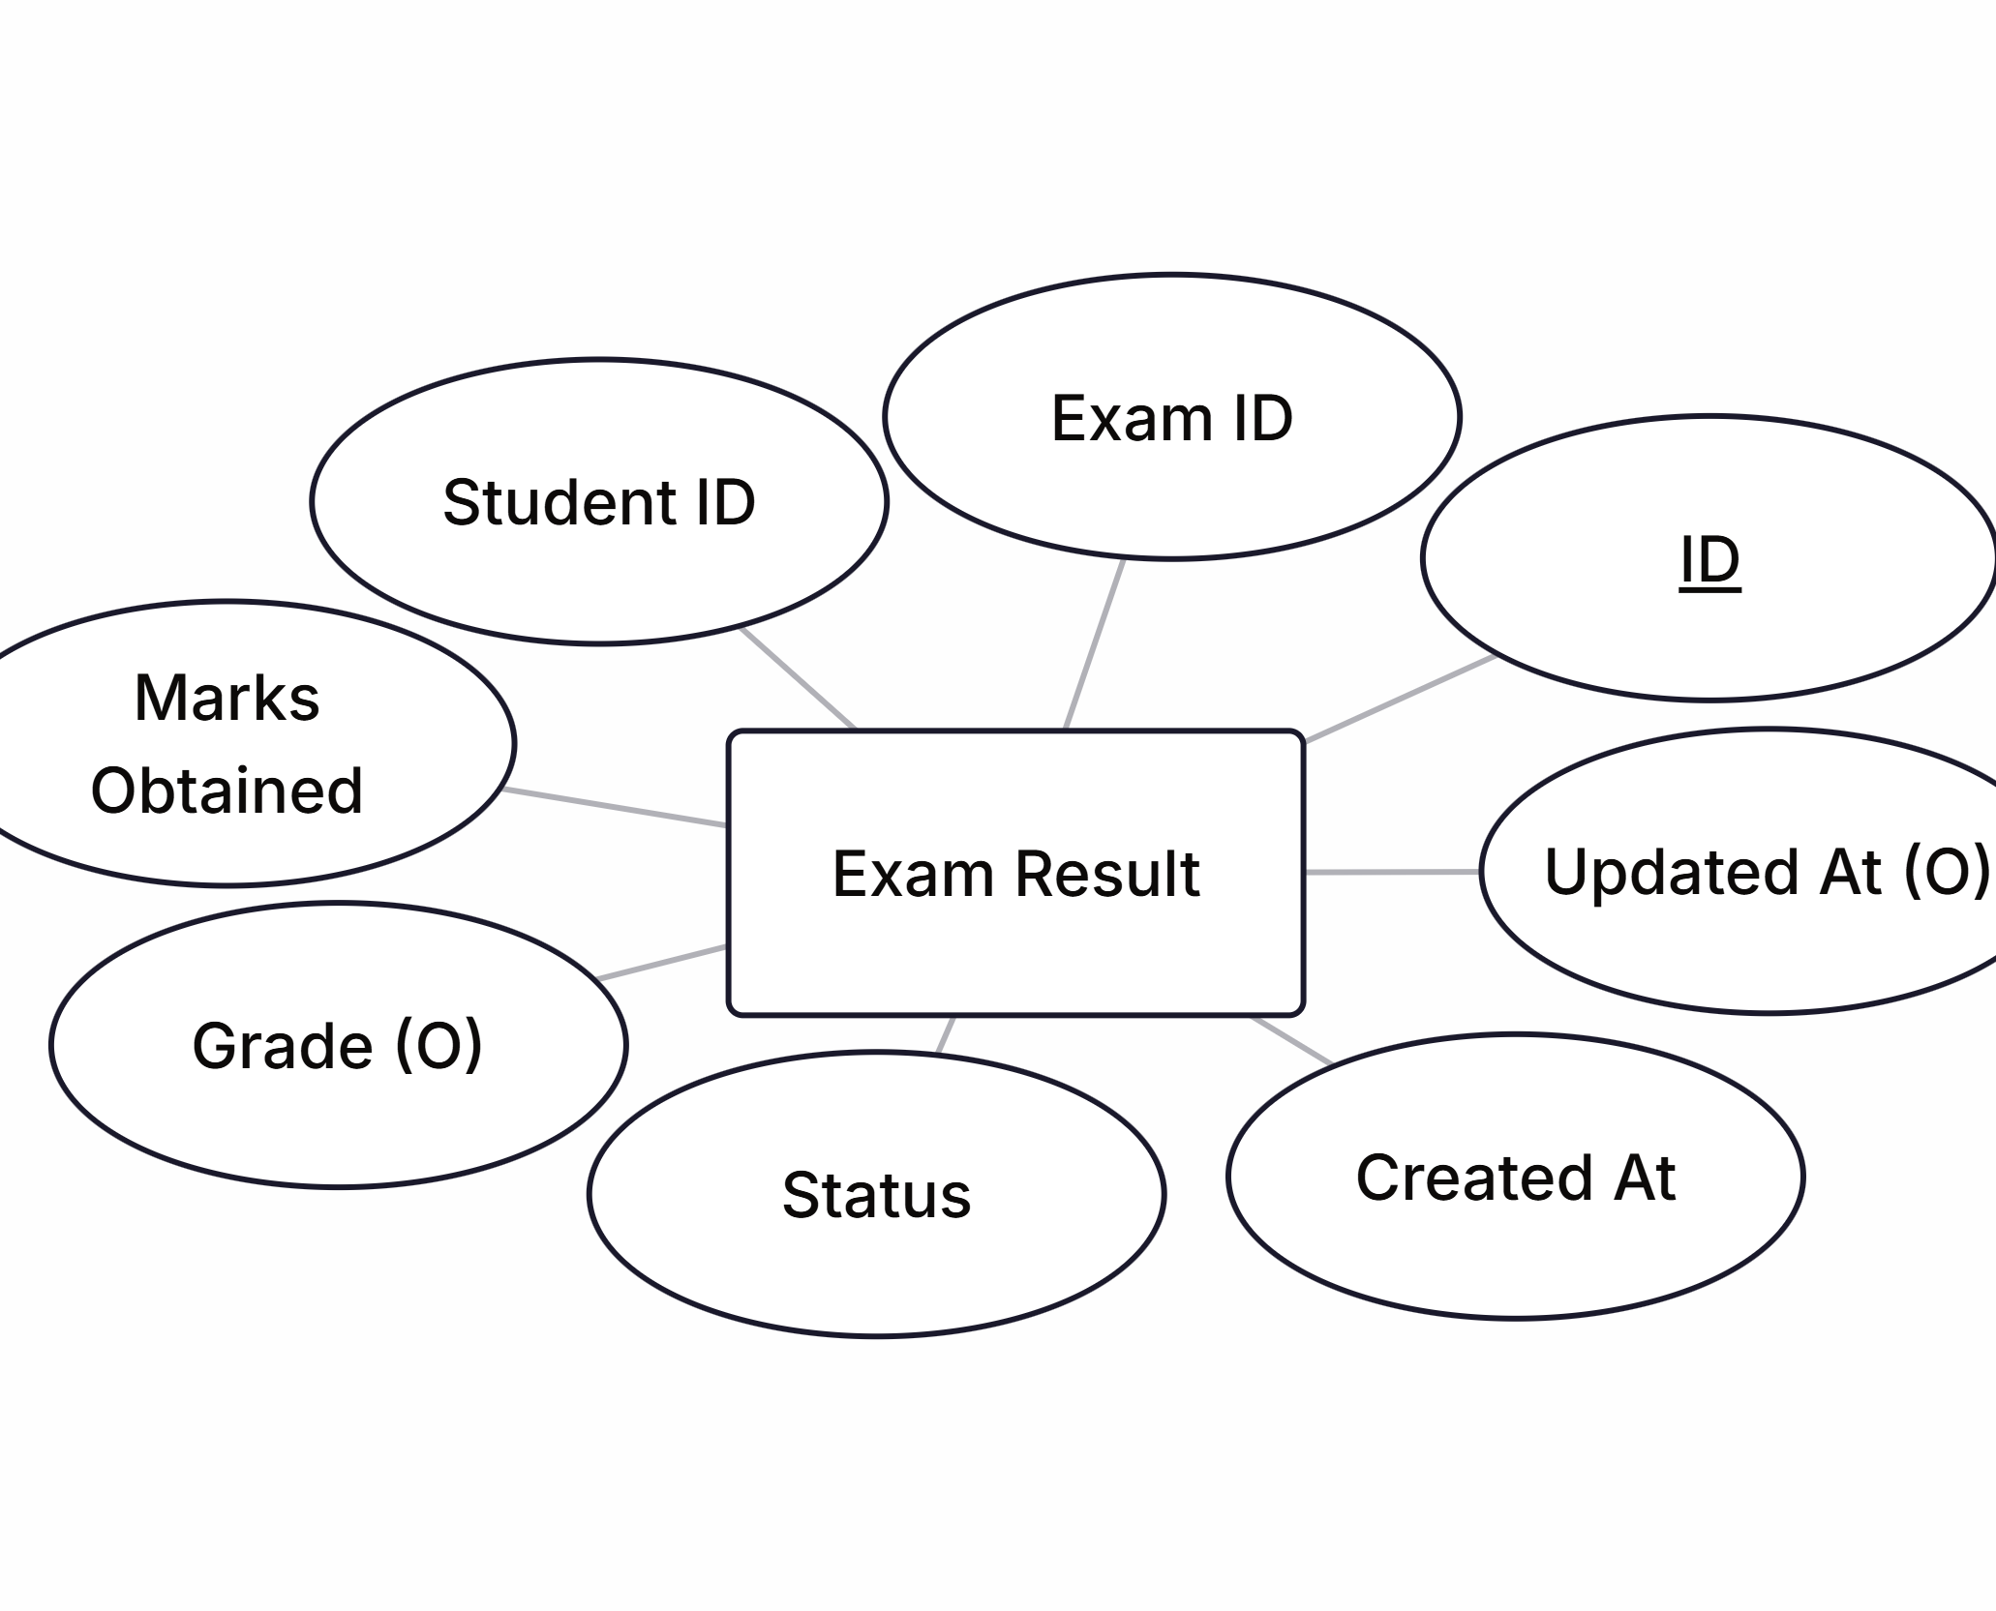
11. Exam Result
The Exam Result is primarily used to notify students with their exam results rather than either manual creation of a list or sending huge excel/PDF file through third-part applications. It has relationships with following entities:
Exam
Student

Slide 15
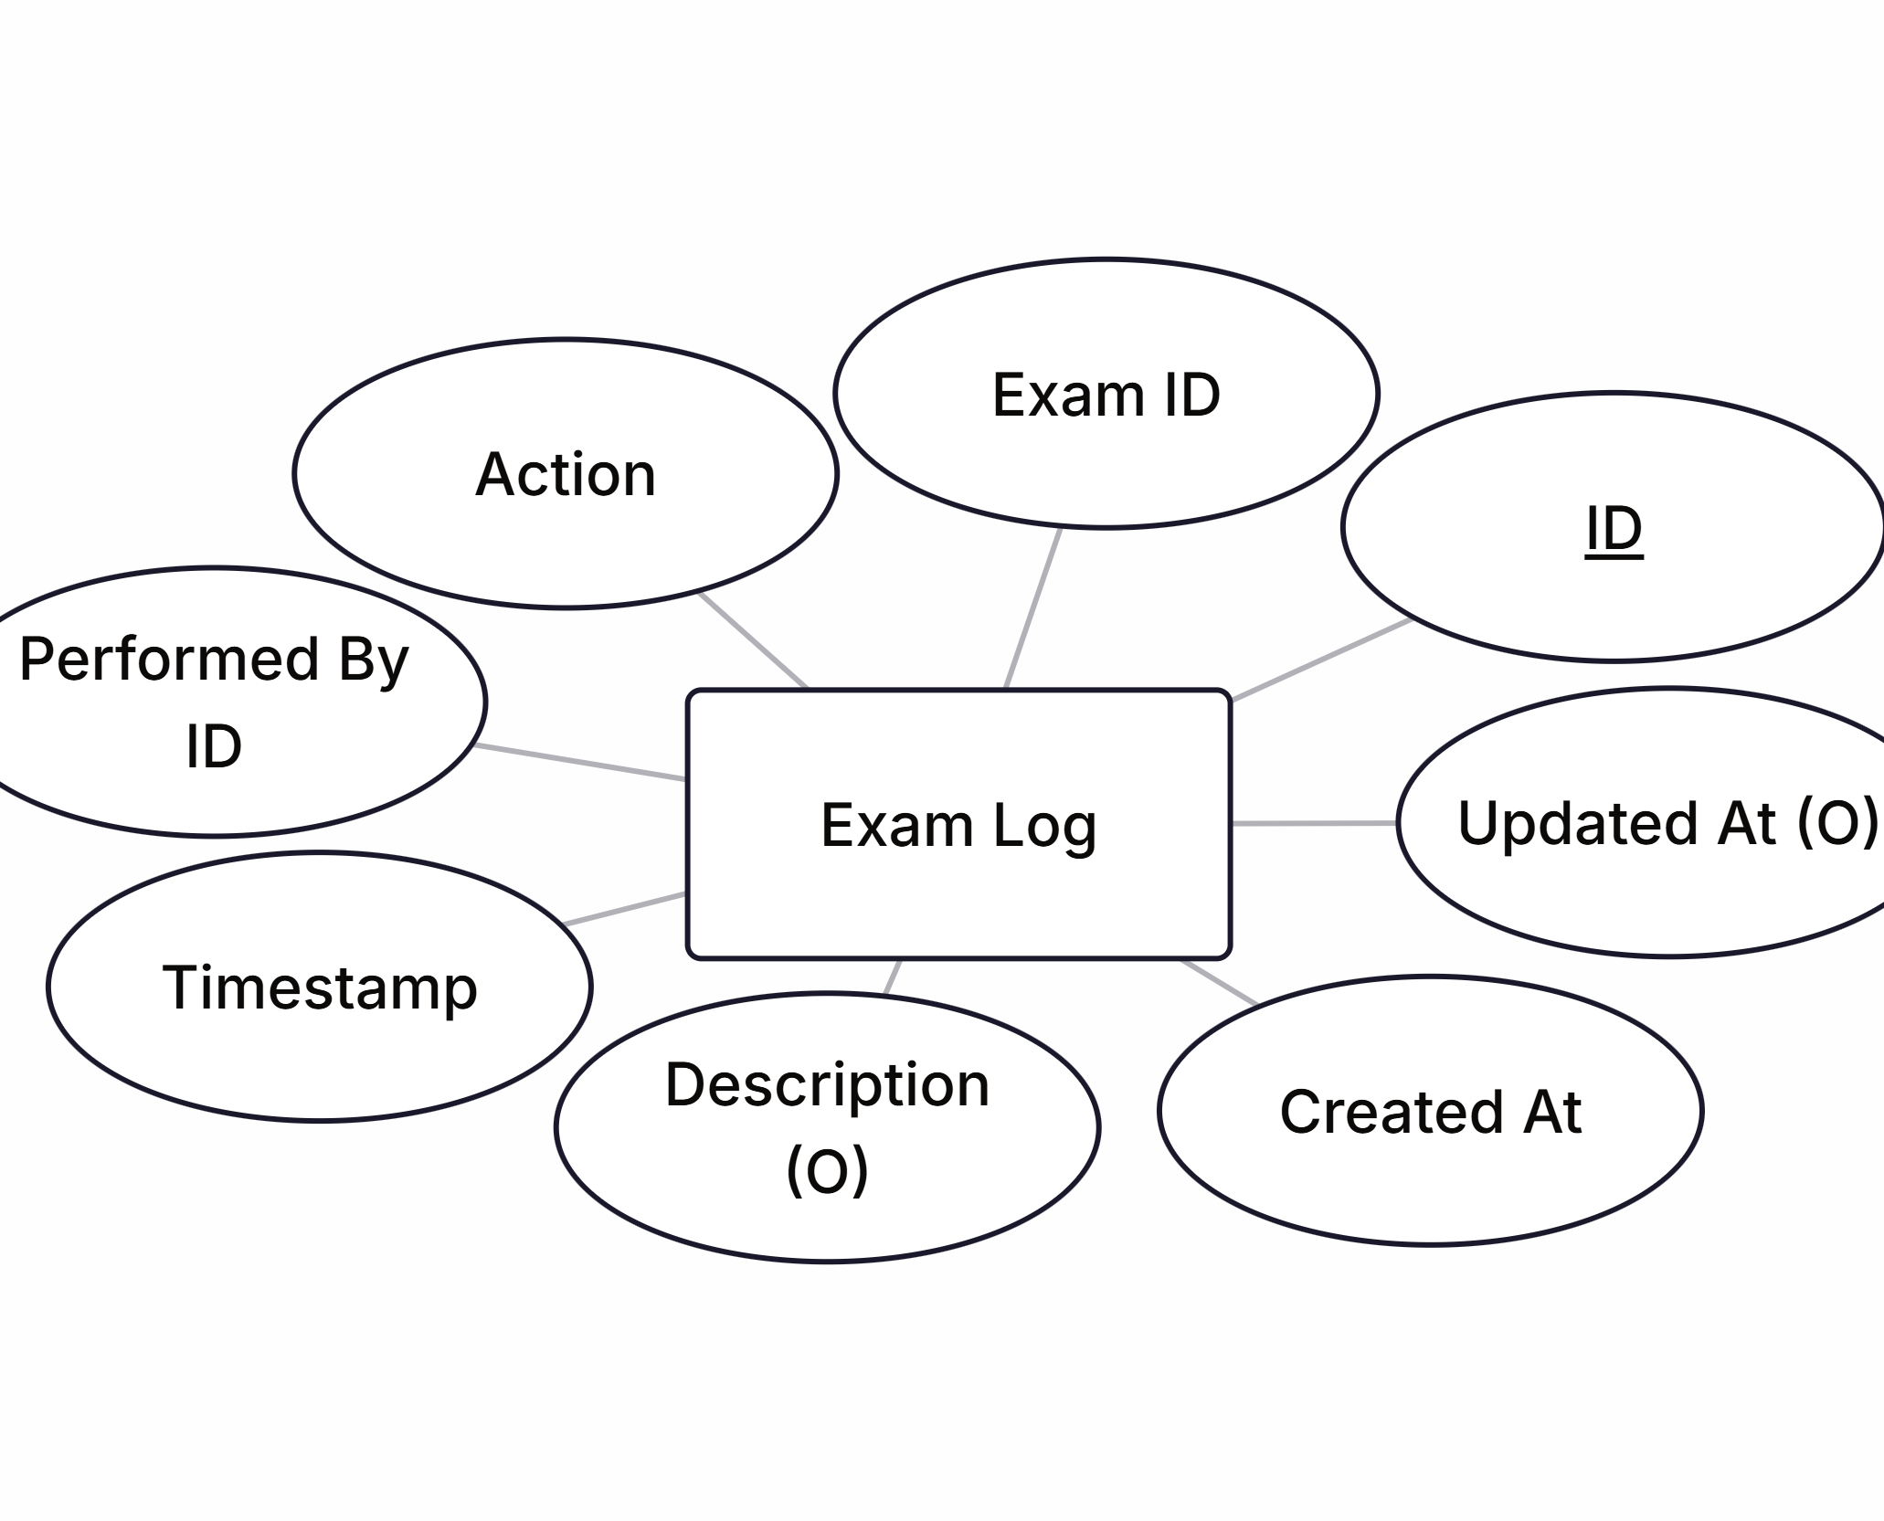
12. Exam Log
The Exam Log is primarily used to audit exam related events and use them with academic event to communicate with workflow and perform communication. IT has relationships with following entities:
Exam
User

Slide 16
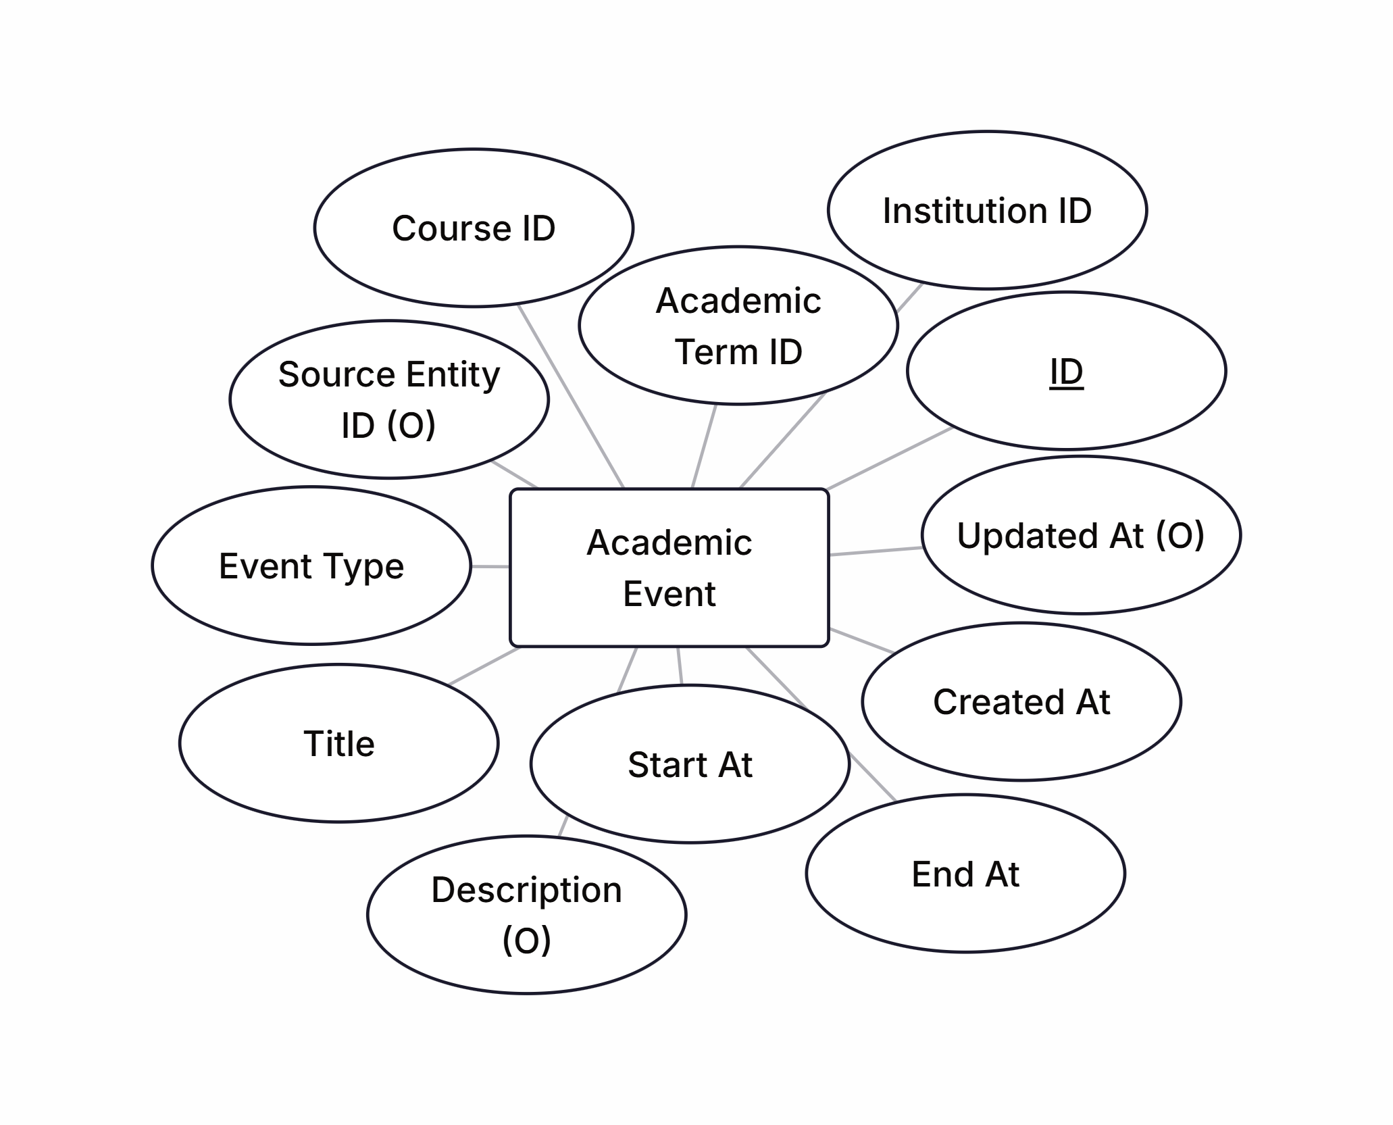
13. Academic Event
The Academic Event acts as a bridge between academic workflow layer and academic data layer. It triggers different events and take actions based on defined automation rules by user. It has relationships with following entities:
Institution
Academic Term
Course
Source Entity

Slide 17
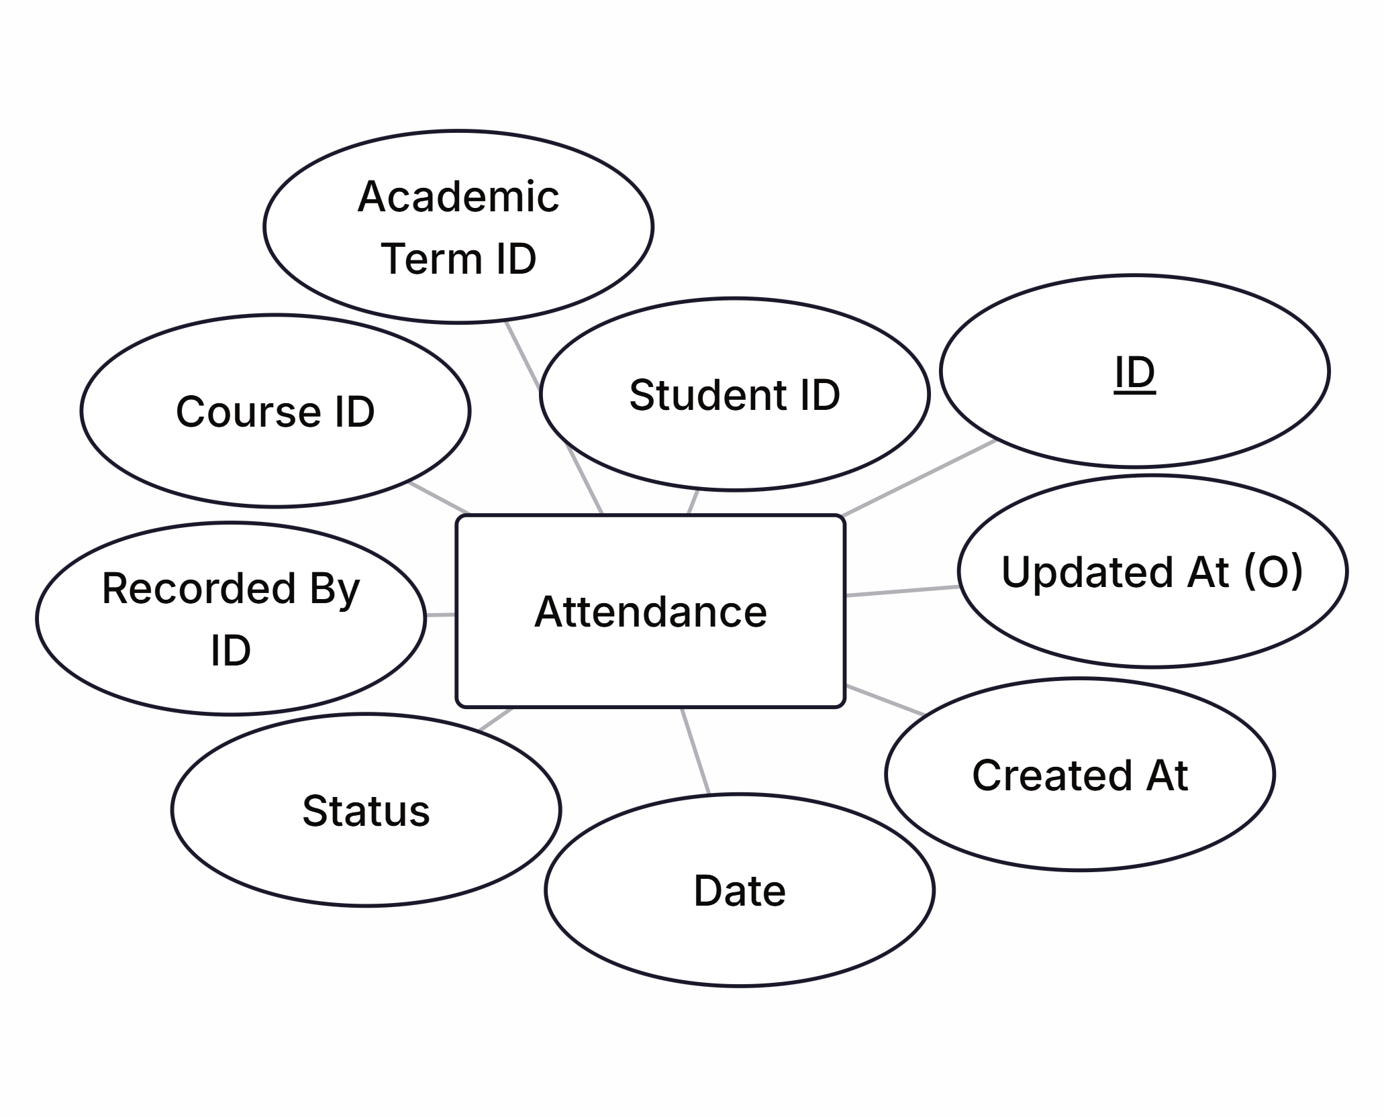
14. Attendance
The Attendance is only used for sending attendance alerts and keep record of students’ attendance. It doesn’t lead to ERP/LMS, it’s just for academic context. It has relationships with following entities:
Student
Course
Academic Term
Faculty Member

Slide 18
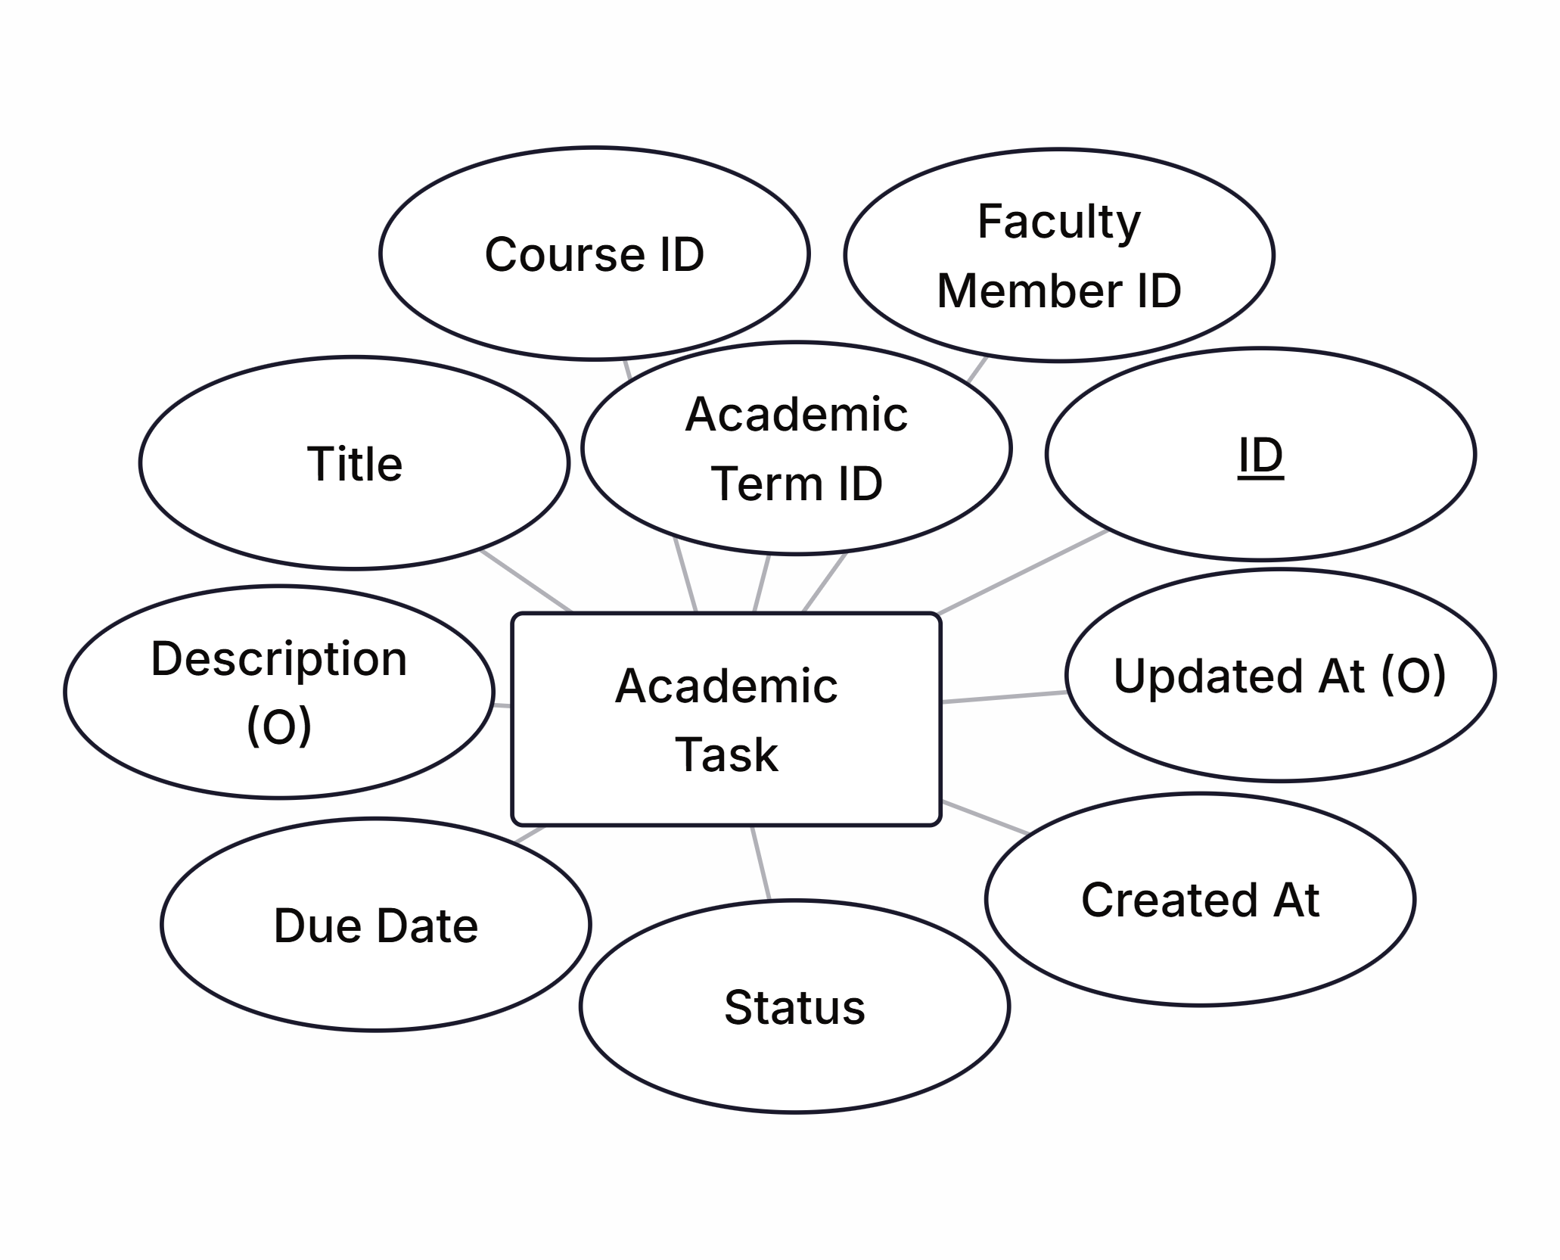
15. Academic Task
The Academic Task is used to notify students about assignments, homework, etc. It has relationship with following entities:
Faculty Member
Course
Academic Term

Slide 19
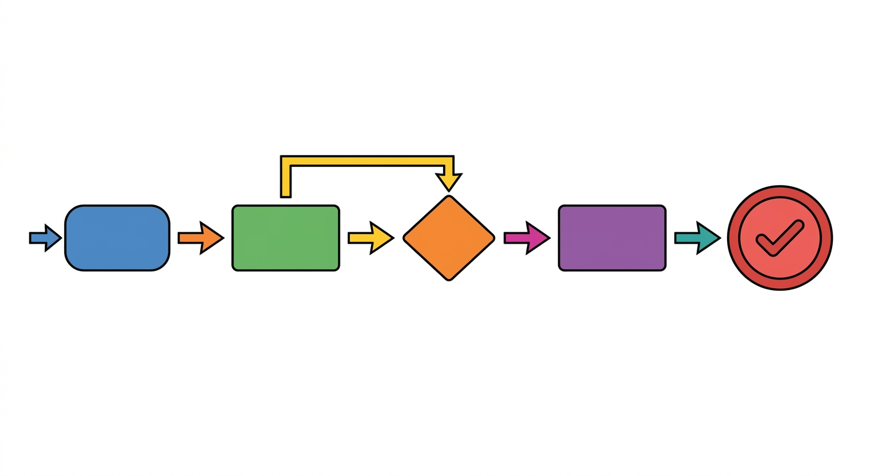
Internal Workflow Section
In this section, we’ll discuss about the internal working of the Academic Data Module and how it works with the communication and workflow layers of our application.

Slide 20
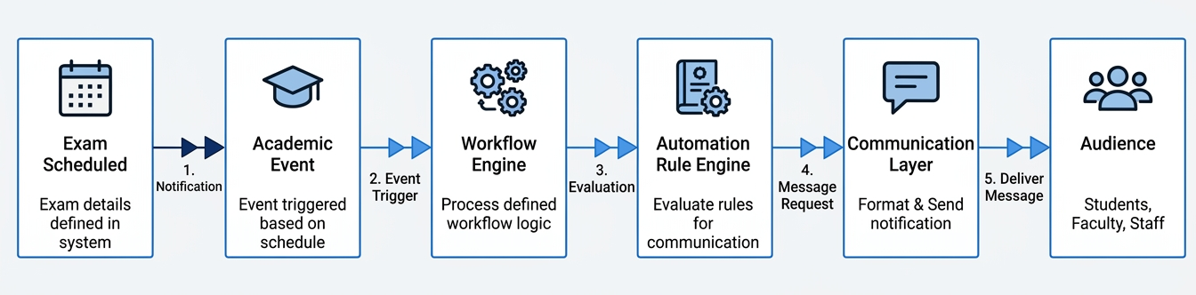
Internal Working Chart with Example
Suppose a faculty member (teacher) schedules a midterm exam of specific course. Now, lets see how the system will work internally.

